Slide 1
Harris County Dept. of Education
Tax Rate Adoption Presentation
October 19, 2022
1

Slide 2
Truth-In-Taxation Calculation
Tax Year 2022
Fiscal Year 2022-2023
Board Presentation
October 19, 2022

Slide 3
$55 Billion
Property Values Growth
FY 2023
$576 Billion
Last eight Fiscal Years
$11 Billion
$27 Billion
FY 2022
$521 Billion
$15 Billion
FY 2021
$510 Billion
$437 Billion
in
FY 2018
Final Estimate
FY 2016
$393 Billion
$33 Billion
$483 Billion
in
FY 2020
$29 Billion
$13 Billion
$422 Billion
in
FY 2017
$450 Billion
in
FY 2019
3

Slide 4
Comparison - Six Year History -
Property Tax Rate $.01 Maximum
15
$.005999
Effective Tax Rate
$338 Billion
16
$.005422
Bellow EffectiveTax Rate
$393 Billion
16%
17
$.0052
Below the ETR
$422 Billion
5th year in a row to recommend BELOW the Effective Tax Rate or NNRR
Last Six Fiscal Years
7%
18
$.005195
Below the ETR
$437 Billion
4%
19
$.005190
Below the ETR
$450 Billion
3%
20
$. $.00500
Below the ETR
7%
$483 Billion
Lowering the tax rate
4

Slide 5
Comparison – Last two years -
Property Tax Rate $.01 Maximum
21
$.004993
Below VAR
$511 Billion
6%
22
$.004990
Below VAR
$521 Billion
2%
23
$.004900
Below VAR
Fiscal Years
10.5%
$576 Billion
$.
Lowering the nominal tax rate
5

Slide 6
Truth-In-Taxation 2022 - Tax Rate Definitions
Nominal Rate – Tax rate to generate revenues to support last year’s approved budget; [ .004900]
No-New Revenue Tax Rate – A calculated rate that provides the taxing unit with the same amount of revenue it received in the year before--on property taxed in both years. TY22 [.004541] TY21 [ .004807 ] TY20 [.004745]
Voter-Approval Tax Rate – A calculated maximum rate allowed by law without voter approval. The rollback rate provides the taxing unit with about the same amount of tax revenue it spent the previous year for day-to-day operations, plus an extra eight percent increase for those operations plus sufficient funds to pay debts in the coming year. TY22 [.004915] TY21 [ .005202] TY20 [.005135]
Maintenance & Operations (M&O) Rate – Tax rate to generate revenues to support general operating expenditures. [ .004900 ]
Debt Service Rate (Sometimes referred to as Interest & Sinking or I&S) – Tax rate to generate revenues obligated for repayment of indebtedness. HCDE currently does not have an I&S rate. All debt is backed by M&O taxes and revenues and not I&S. N/A [ .000000 ]
Total Tax Rate – The M&O and I&S tax rates combined. (Proposed)
[ .004900 ]
6

Slide 7
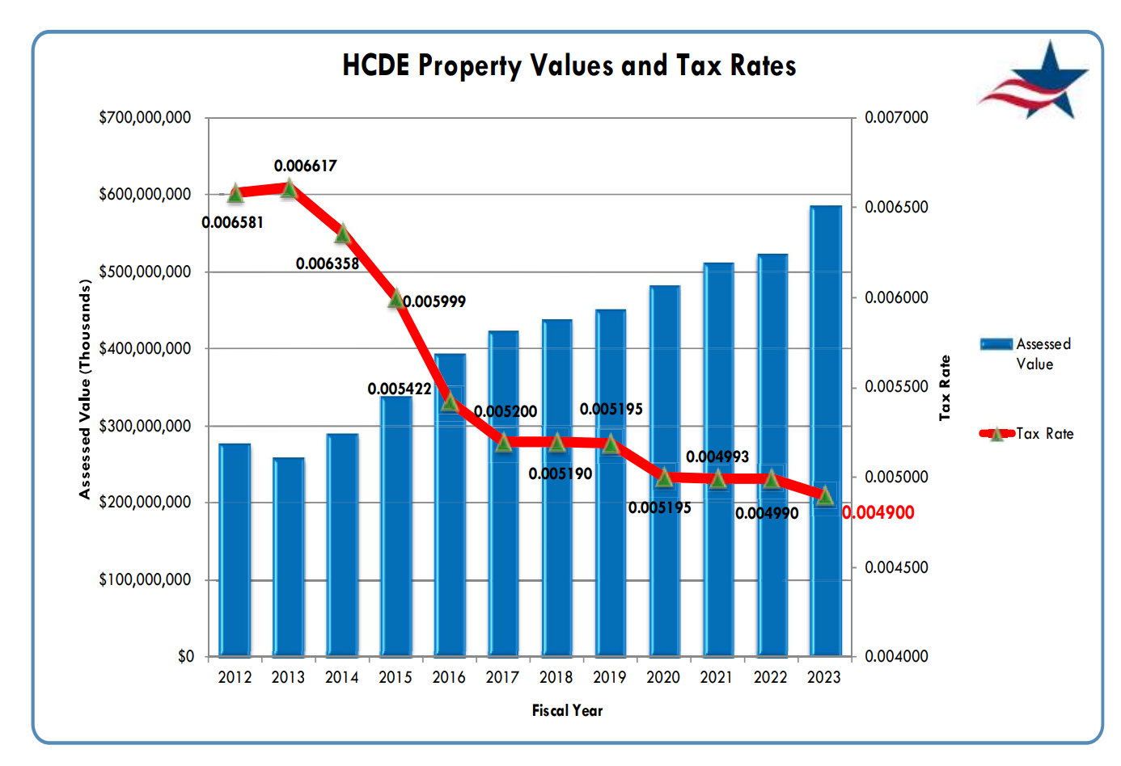

Slide 8
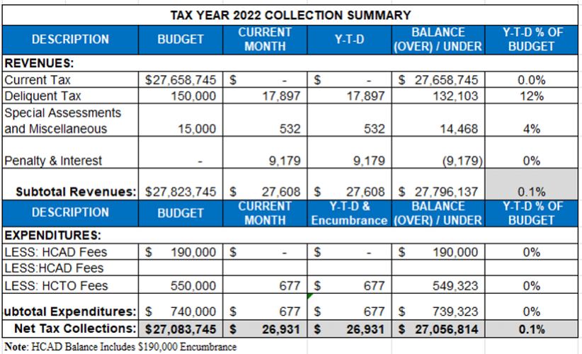
Monthly Tax Collection Report
September 2022

Slide 9
Estimated Tax Rate
9

Slide 10
NEXT STEP
THIS TAX RATE WILL RAISE MORE TAXES FOR MAINTENANCE AND OPERATIONS THAN LAST YEAR'S TAX RATE. THE TAX RATE WILL EFFECTIVELY BE RAISED BY 7.67 PERCENT AND WILL RAISE TAXES FOR MAINTENANCE AND OPERATIONS ON A $100,000 HOME BY APPROXIMATELY $-0.09.
Current Tax Rate (Nominal) .004990
No-New Revenue Tax Rate .004541
Recommended (M&O) Tax Rate .004900
Voter-Approval Tax Rate .004915
I move that the property tax rate be increased by the adoption of a tax rate of 0.004900, which is effectively a 7.91 percent increase in the tax rate.

